Slide 1



Halight Performance Intelligence Dashboard
Transforming Raw Data into Real-Time Business Decisions
Aum · Sakshi · Souravdeep · Faiyaz · Priyanka
Group 8 | St. Clair College — Capstone Project II
Notes:
"Our user profile analysis reveals a few critical hurdles. We have a clear foundation, but retention and market distribution are currently our biggest challenges."
Critical Bottlenecks "We are facing a major Churn Problem with many deleted accounts, and a Verification Gap where over half our users remain unverified. Additionally, a significant number of 'Ghost Accounts' have never even logged in, signaling a need for better onboarding."Market Dynamics "While we have US Dominance, engagement is lagging in Canada (CA) and Mexico (MX). Furthermore, our reliance on a few key retail clients creates a concentration risk that we must address through diversification.

Slide 2






The Problem We Are Solving
Halight has a data visibility gap that delays critical leadership decisions.
Millions of daily interactions are generated without a unified real-time view.
No live view of which users are at risk of leaving (churn).
Our Solution
A live Information Radiator Dashboard — always-on, auto-updating, and built for real-time strategic decisions, not spreadsheets.
Inability to identify underperforming retail clients instantly.
Reports are manual, delayed, and disconnected from immediate action.

Slide 3
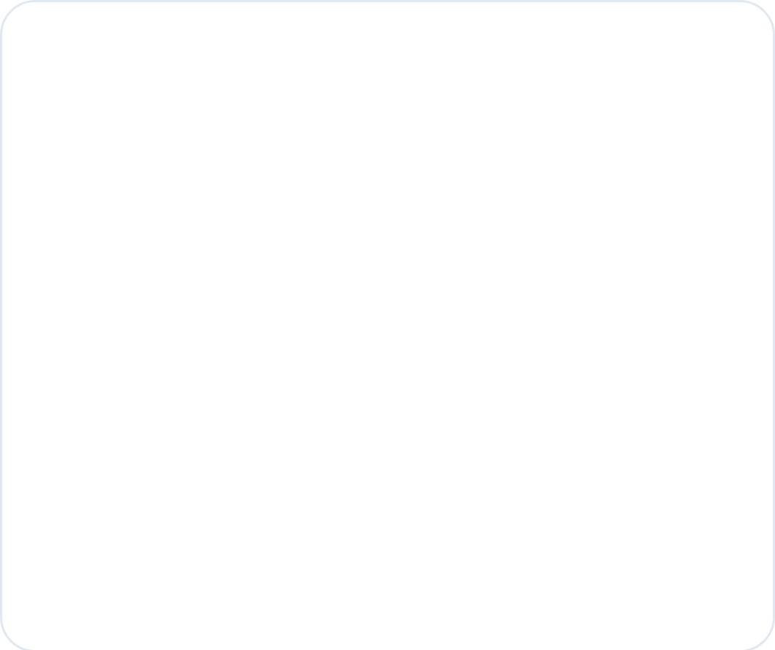
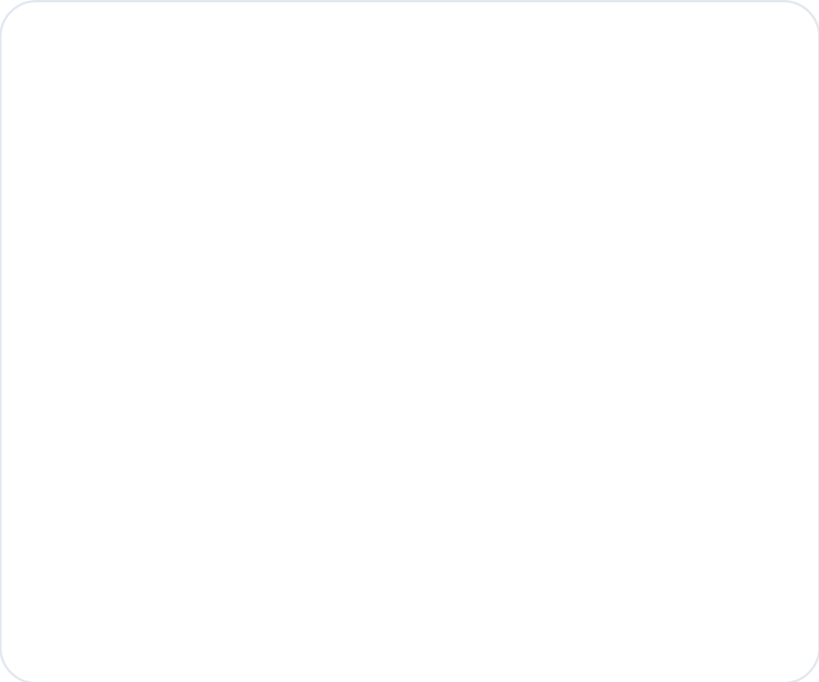
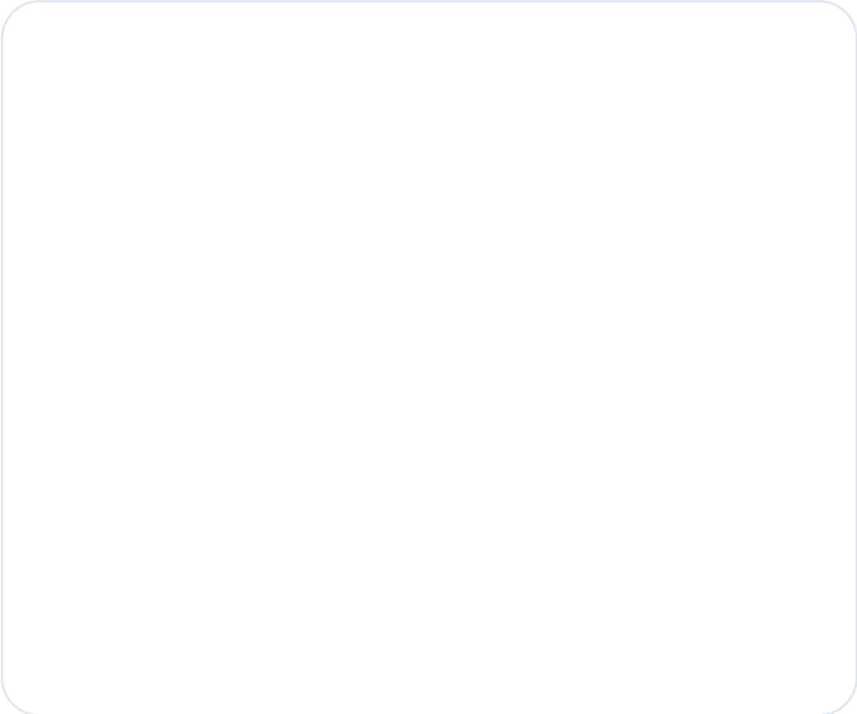



Project Overview
An end-to-end data intelligence system covering three critical layers.
LAYER 1
LAYER 2
LAYER 3
Data Engineering
Analytics & ML
Live Dashboard
Connected directly to Halight's AWS Athena database. Built a caching pipeline for instant dashboard loading without repeated AWS queries.
Analyzed 475,000+ records. Developed churn prediction, user segmentation (RFM), and engagement scoring models.
A 5-page Flask web dashboard displaying real-time KPIs, ML predictions, and AI-generated insight summaries.

Slide 4
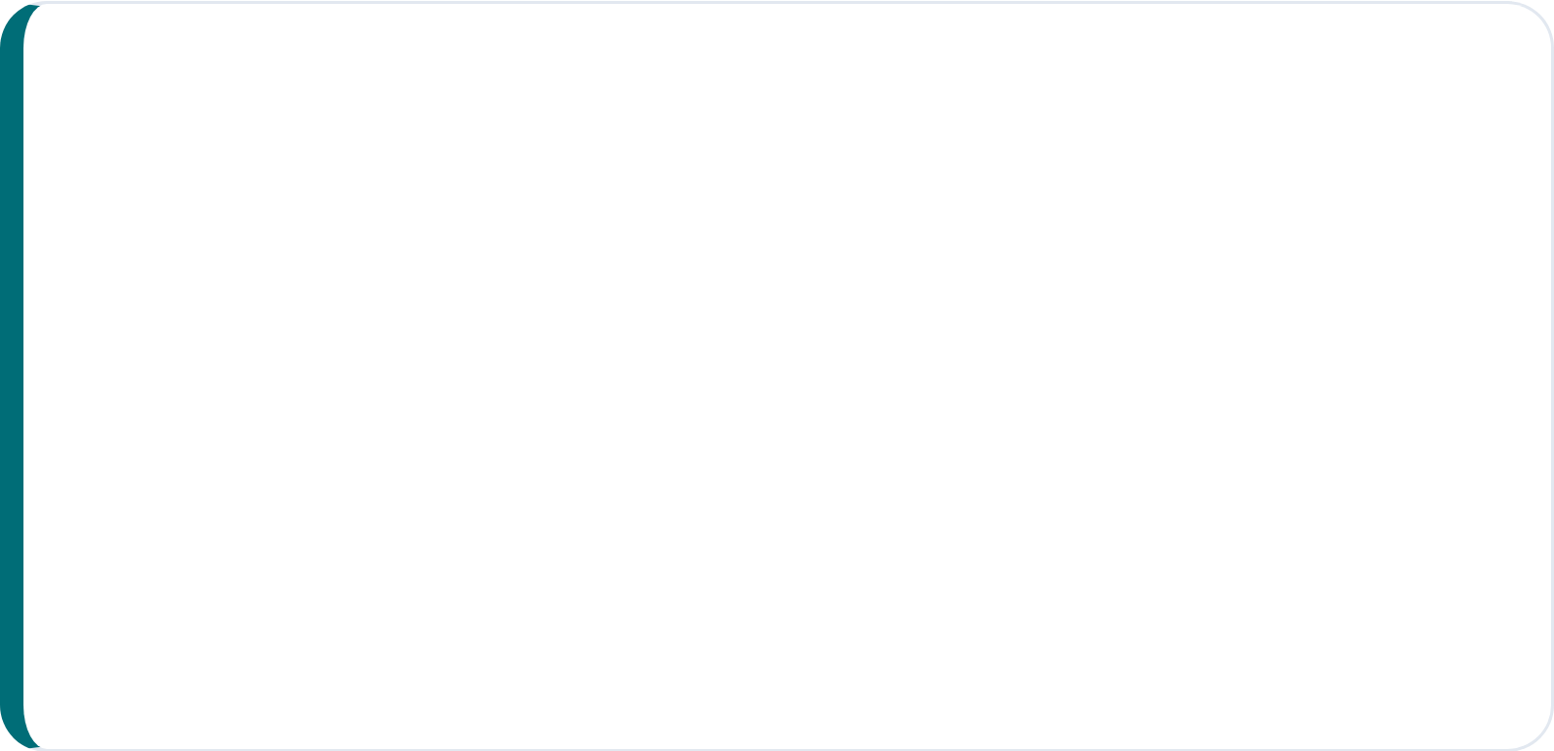




The Dataset at a Glance
Core Data Components
32 Tables:Total database structure analyzed.
Key Features Captured
Users:Identity, status, and lifecycle tracking.
Account verification & geographic region
Activity:Learning attempts, claims, and comments.
Learning completions & active days
Points, achievements & referral activity
Views:Aggregated lifetime stats and monthly versions.

Slide 5
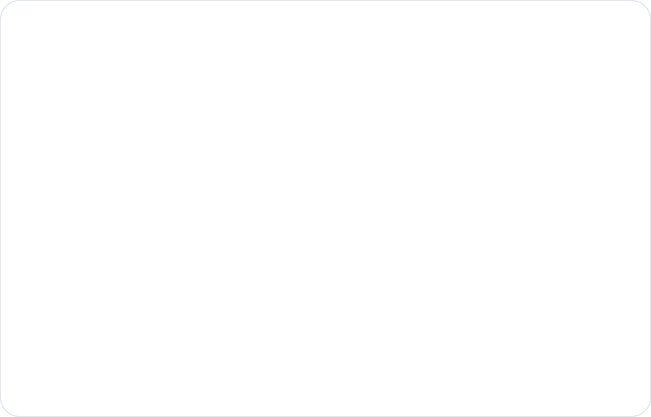
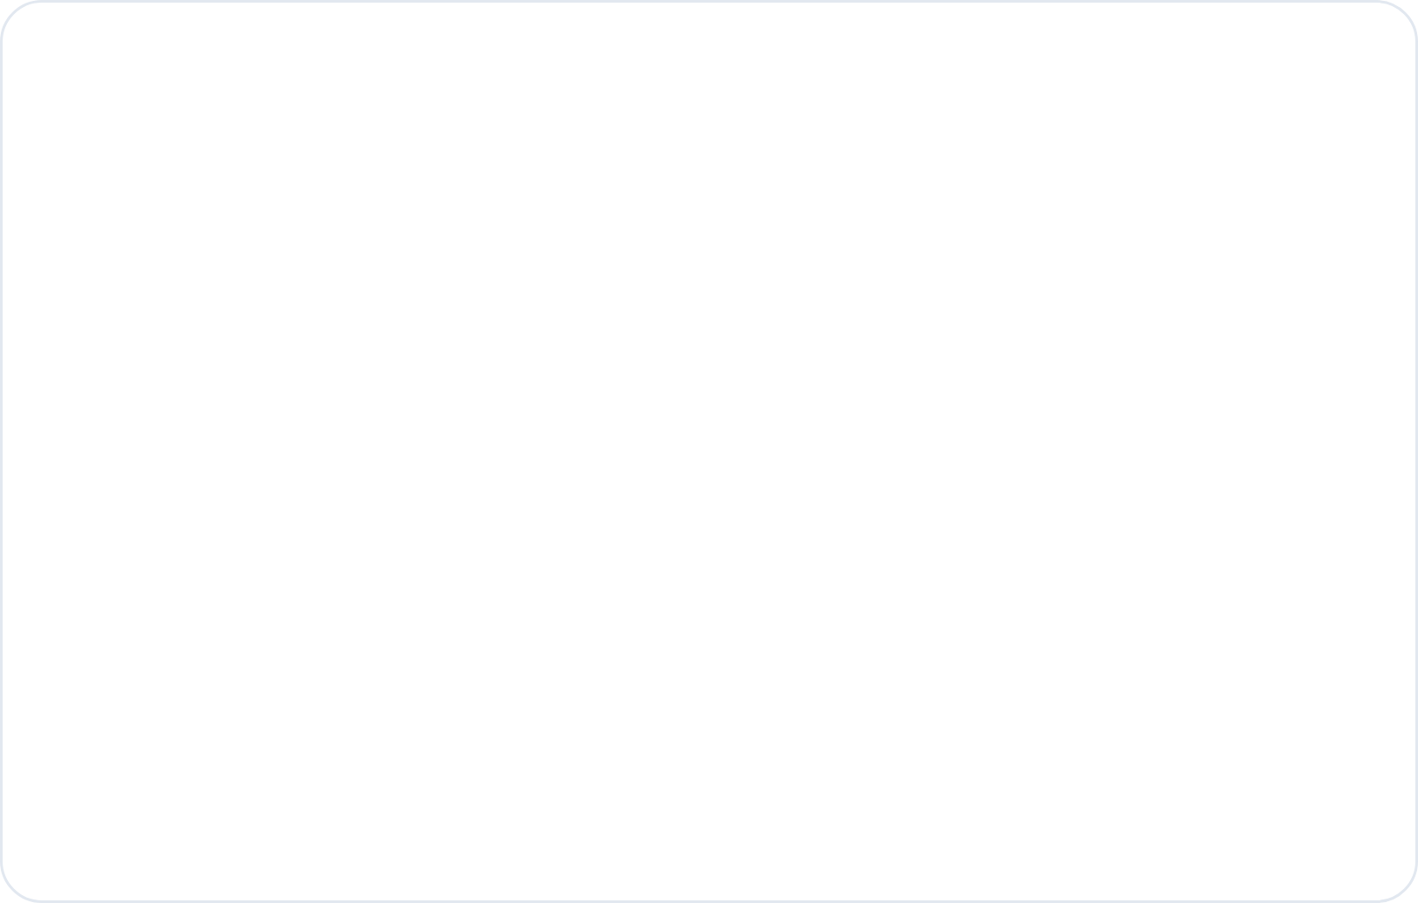
Who Are the Users?
Key findings from our comprehensive user profile analysis.
Critical Bottlenecks
Market Dynamics
Churn Problem:Massive portion of users are deleted/disabled.
US Dominance:Primary market; CA & MX lagging in engagement.
Verification Gap:< 50% of users have ever verified accounts.
Retail Dominance:Health depends on few key client relationships.
Ghost Accounts:Measurable percentage never logged in once.
Notes:
"Our user profile analysis reveals a few critical hurdles. We have a clear foundation, but retention and market distribution are currently our biggest challenges."
"We are facing a major Churn Problem with many deleted accounts, and a Verification Gap where over half our users remain unverified. Additionally, a significant number of 'Ghost Accounts' have never even logged in, signaling a need for better onboarding."
"While we have US Dominance, engagement is lagging in Canada (CA) and Mexico (MX). Furthermore, our reliance on a few key retail clients creates a concentration risk that we must address through diversification.

Slide 6
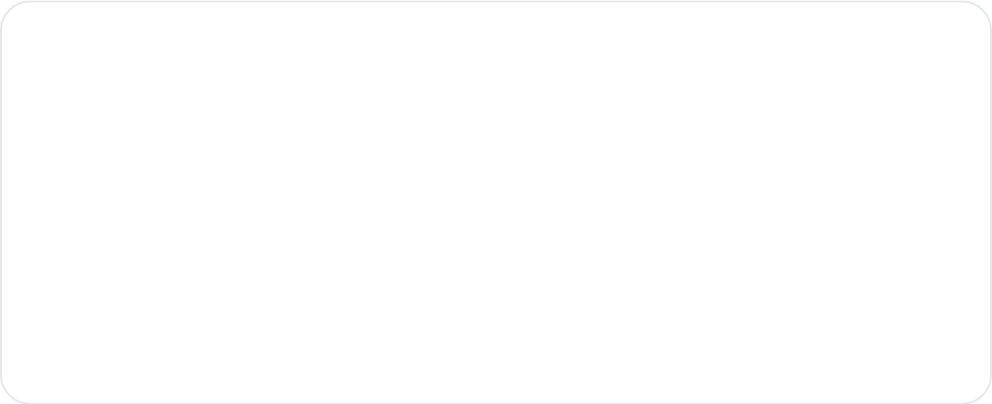
Engagement Deep Dive
The platform faces a significant dual-population problem.
Strategic Implications
Inactive Majority:Most users have zero or near-zero activity.
80/20
Power User Minority:Small segment drives disproportionate activity.
ACTIVITY DISTRIBUTION
Extreme power-law curves rather than normal distributions.
Retention:Losing power users has outsized impact.
Growth:Converting even 1% of inactives is massive.
Notes:
"Our engagement follows a classic 80/20 distribution. Instead of a steady 'normal' curve, we see an extreme power-law where a tiny minority is doing most of the heavy lifting. This creates two distinct groups we need to manage differently."
The Inactive Majority: Most users have zero to near-zero activity. They are currently 'dormant' on the platform.
The Power User Minority: A small segment drives the vast majority of our activity. This means Retention is critical—losing even one power user has an outsized negative impact on our metrics.
The Growth Opportunity: Because the inactive group is so large, converting even 1% of them into active users would lead to massive, exponential growth.

Slide 7
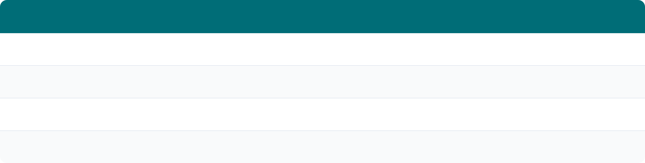




User Segmentation (RFM Model)
Segmenting every user into actionable groups using Recency, Frequency, and Monetary scores (3–15).
Segment
Definition
Business Action
RFM score 12–15
Protect and reward — highest retention priority
Power Users
RFM score 8–11
Nurture with targeted content and incentives
Casual Users
RFM score 5–7
Re-engagement campaigns before they churn
At-Risk Users
RFM score 3–4
Win-back or sunset — lowest conversion probability
Inactive Users
Note: RFM produces segments directly actionable by marketing teams without interpretation.

Slide 8
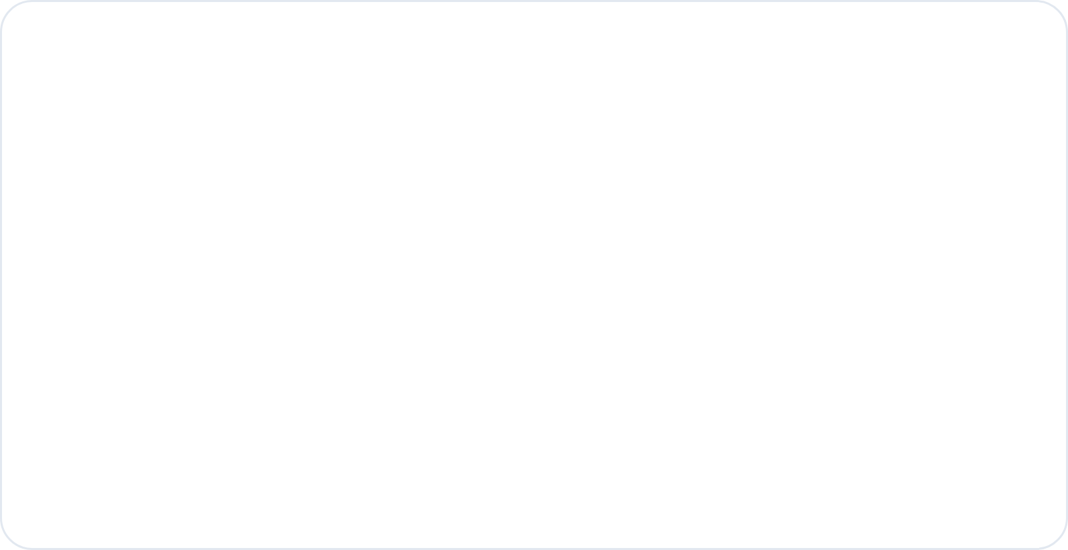
Churn Prediction Model
Model Specifics
Algorithm:XGBoost Classifier.
Risk Tiers
High Risk
≥ 0.7
Training:200,000 user sample.
Medium Risk
0.4 – 0.7
Features:18 signals (completions, active days, etc).
Low Risk
< 0.4
Design:Excluded "days since last login" to ensure real-world utility.
High Risk users are surfaced on the Marketing Action Board for immediate retention campaigns.

Slide 9
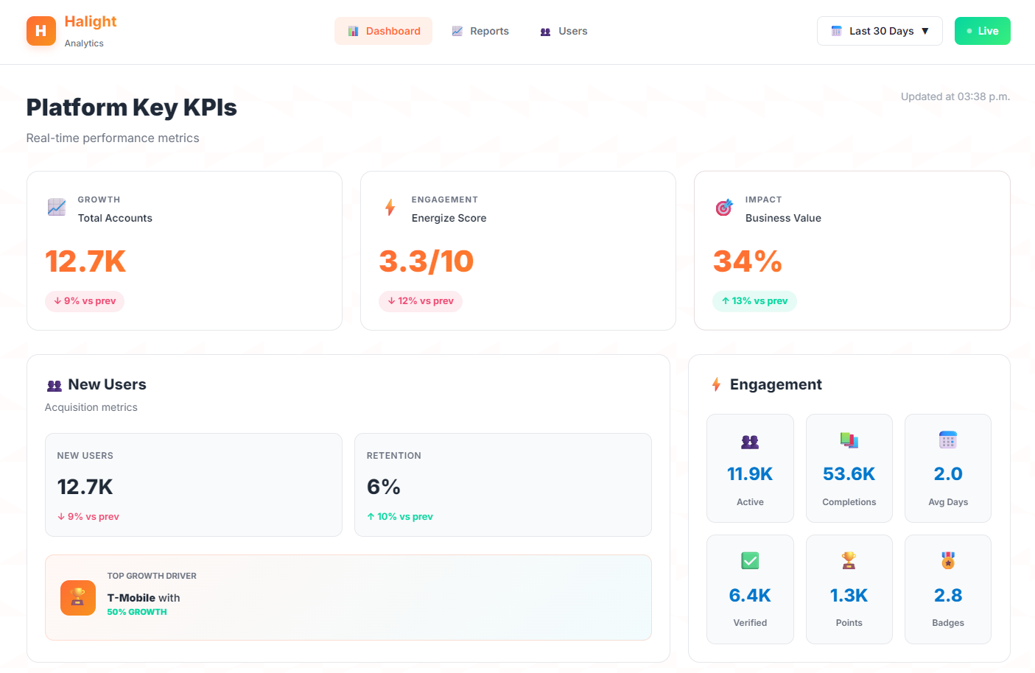
Dashboard Preview
Work in Progress - 5-Page Integrated Flask Web Dashboard

Slide 10
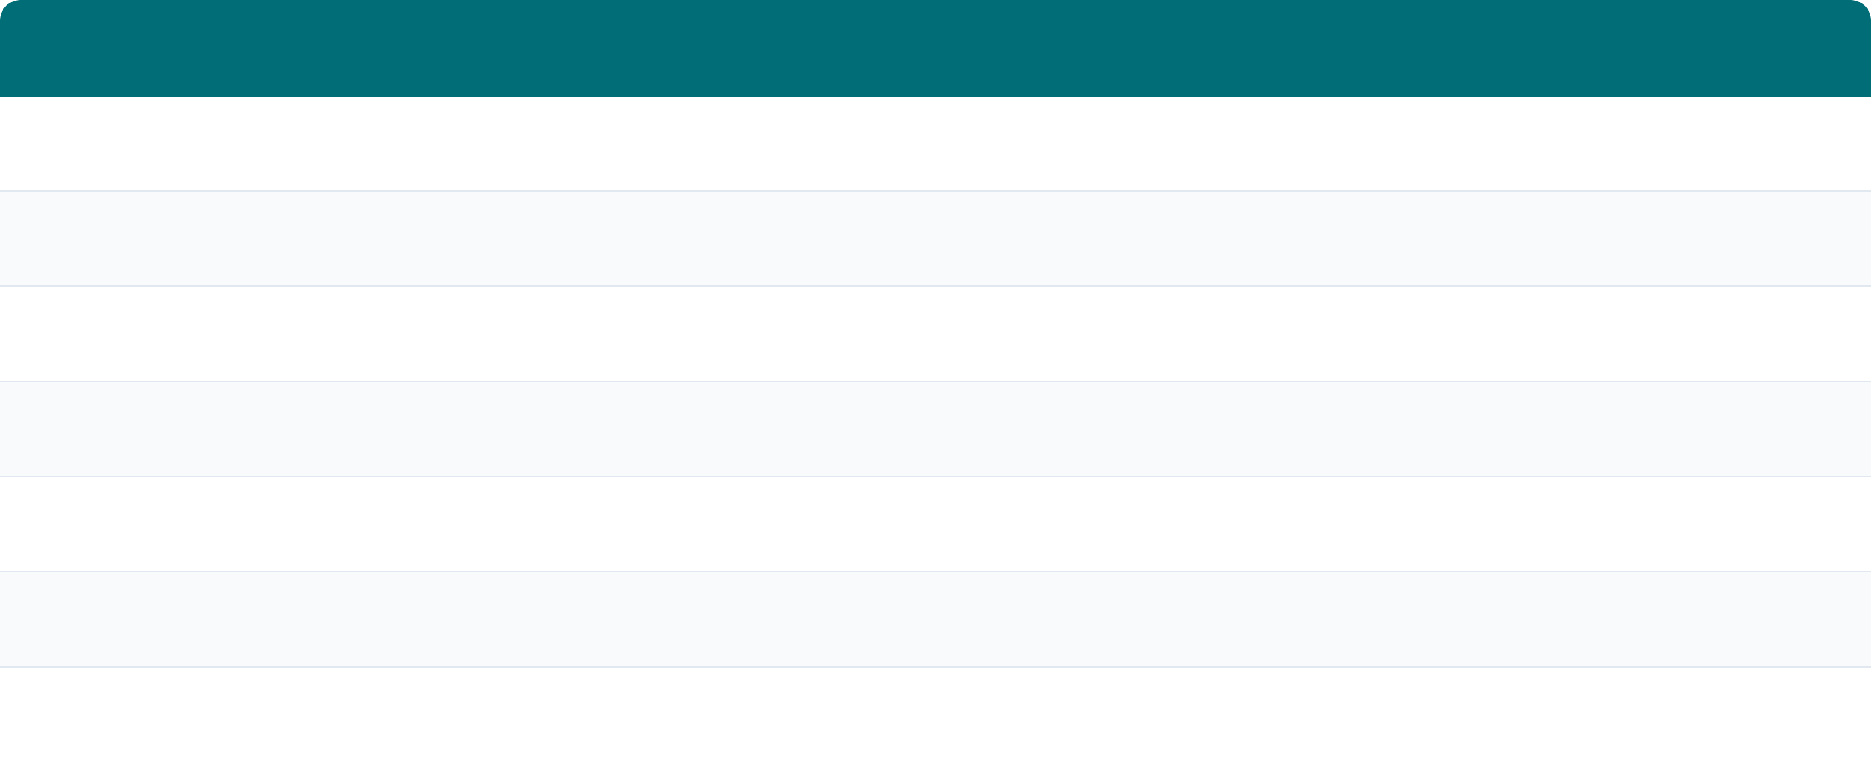




What's Next
Component
Status
AWS Athena Data Pipeline
Complete
Users Table Analysis & Cleaning
Complete
Churn Prediction Model (v2)
Complete
RFM User Segmentation
Complete
Engagement Analysis Notebook
In Progress
Production ML Models
In Progress
Dashboard UI (Flask)
In Progress
Remaining Milestones: Complete cross-table analysis → finalize production models → connect dashboard to live data → client presentation.

